Slide 1
Binary Search Tree Traversal In Order Traversal (LNR)
if (t) {
InOrder(t→left);
visit(t);
InOrder(t→right);
}
70
70
70
70
InOrder(NULL)
InOrder(37→left)
InOrder(21→left)
50
50
50
85
85
50
85
85
InOrder(21)
visit(37)
InOrder(37)
visit(21)
t=37
InOrder(37→right)
InOrder(21→right)
t=21
30
30
30
30
InOrder(30→left)
InOrder(NULL)
visit(30)
InOrder(30)
t=30
21
37
InOrder(30→right)
21
21
37
21
37
37
InOrder(50→left)
InOrder(85)
InOrder(85→left)
t=85
InOrder(50)
visit(50)
t=50
visit(85)
InOrder(50→right)
21
30
37
50
70
85
InOrder(85→right)
InOrder(70→left)
visit(70)
t=70
InOrder(70)
InOrder(70→right)

Slide 2
BST Print (Inorder traversal)
template <class type>
void tree<type>::Print() {
InOrder(root);
}
template <class type>
void tree<type>::InOrder(Node<type> *t)
{
if (t) {
InOrder(t→left);
visit(t);
InOrder(t→right);
}
}
template <class type>
void tree<type>:: ::visit(Node<type> *t){ cout << t→data;
}

Slide 3
Binary Tree Traversal In Order Traversal (LNR)
if (t) {
InOrder(t→left);
visit(t);
InOrder(t→right);
}
A
A
A
A
B
B
B
B
K
K
K
K
C
C
C
C
H
H
H
H
L
L
L
L
X
X
X
X
Q
Q
Q
Q
M
M
M
M
P
P
P
P
Q
C
M
B
H
A
L
K
X
P

Slide 4
Binary Tree Traversal Pre Order Traversal (NLR)
A
A
A
A
B
B
B
B
K
K
K
K
C
C
C
C
H
H
H
H
L
L
L
L
X
X
X
X
if (t) {
visit(t);
PreOrder(t→left);
PreOrder(t→right);
}
Q
Q
Q
Q
M
M
M
M
P
P
P
P
A
B
C
Q
M
H
K
L
X
P

Slide 5
Binary Tree Traversal Pre Order Traversal (NLR)
void BinaryTree::PreOrder()
{
PreOrder(root);
}
void BinaryTree::PreOrder(TreeNode *t)
{
if (t) {
visit(t);
PreOrder(t→left);
PreOrder(t→right);
}
}
void BinaryTree::visit(TreeNode *t) {
cout << t→data;
}

Slide 6
Binary Tree Traversal Post Order Traversal (LRN)
A
A
A
A
B
B
B
B
K
K
K
K
C
C
C
C
H
H
H
H
L
L
L
L
X
X
X
X
if (t) {
PostOrder(t→left);
PostOrder(t→right);
visit(t);
}
Q
Q
Q
Q
M
M
M
M
P
P
P
P
Q
M
C
H
B
L
P
X
K
A

Slide 7
Binary Tree Traversal Post Order Traversal (NLR)
void BinaryTree::PreOrder()
{
PostOrder(root);
}
void BinaryTree::PostOrder(TreeNode *t)
{
if (t) {
PostOrder(t→left);
PostOrder(t→right);
visit(t);
}
}
void BinaryTree::visit(TreeNode *t) {
cout << t→data;
}

Slide 8
Binary Tree Traversal
A
Time for Traversal
Best case
Worst case
B
K
C
H
L
X
Q
M
P
NLR – visit when at the left of the Node
A
B
C
Q
M
H
K
L
X
P
LNR – visit when under the Node
Q
C
M
B
H
A
L
K
X
P
LRN – visit when at the right of the Node
Q
M
C
H
B
L
P
X
K
A

Slide 9
Binary Tree Destructor
Which Algorithm?
Delete both the left child and right child before deleting itself
LRN (post order)

Slide 10
Destructor
POST ORDER traversal
void tree<type>::~tree() {
Destroy(root);
}
template <class type>
void tree<type>::Destroy(Node<type> *& node) {
if (node) {
Destroy(node→left);
Destroy(node→right);
delete node;
}
}

Slide 11
Duplicate Tree –Copy constructor
PRE ORDER traversal
template <class type>
void tree<type>::Duplicate(Node<type>*curr_tree,Node<type>*& dup_tree){
if (curr_tree) {
// set the value from curr_tree
dup_tree = new Bnode(curr_tree→data);
Duplicate(curr_tree→left, dup_tree→left);
Duplicate(curr_tree→right, dup_tree→right);
}
}

Slide 12
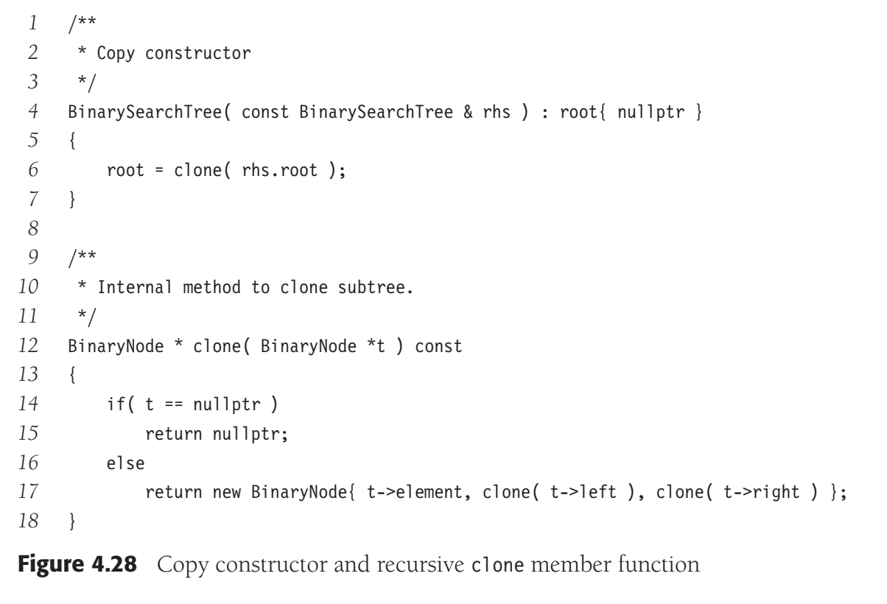
copy constructor
first initializing root to nullptr and then making a copy of rhs. We use a very slick recursive function named clone to do all the dirty work

Slide 13
Tree traversal
In-order
Sorted data printing
Post Order
Destructor
Pre Order
Create a Tree copy (duplicate the current tree)
HW
Do Iterative versions of the traversals

Slide 14
BST DELETION

Slide 15
Deleting a leaf node
J
Delete Z
B
Q
A
D
L
R
✗
φ
F
Z
E

Slide 16
Deleting a node with only one child
J
Delete R
Delete F
B
Q
✗
A
D
L
R
✗
F
Z
E

Slide 17
Deleting a node with 2 children (without duplication)
J
Delete Q
B
Q
Q
P
R
A
D
L
Y
✗
R
Z
K
N
S
✗
S
M
P
Largest from left subtree
(Predecessor)
smallest from right subtree
(Successor)

Slide 18
Delete a node from a BST (without duplication)
Search the node to be deleted; call it t
If t is a leaf,
disconnect it from its parent and set the parent pointer to NULL
If t has only one child,
remove t from the tree by making t’s parent point to its child.
If t has two children
Find the largest/smallest among t’s LST/RST; call it p.
Copy p’s information into t.
Delete p.

Slide 19
Delete(without duplication)
Delete 2
15
Delete 7
14
Delete 10
Delete 40
5
25
Delete 35
Delete 15
2
10
8
18
35
31
14
30
40
1
7
6
28
31
44
6
8
13
27

Slide 20
Delete (with Duplication)
15
14
Delete 10
5
25
2
10
7
18
35
?
13
30
40
1
7
28
31
44
6
7
13
27
Solution :Use Successor instead of Predecessor

Slide 21
Delete (with Duplication)
15
14
Delete 10
5
25
2
10
13
18
35
13
30
40
1
7
28
31
44
6
7
13
27

Slide 22
Recursive Delete
void tree<type>::deleteR(type d)
{
deleteR(d, root);
}
template <class type>
void tree<type>::deleteR(type d, Node<type> *& node) {
if (node) {
if (d > node→data)
deleteR(d, node→right);
else if (d < node→data)
deleteR(d, node→left);
else
deleteNode(node);
}
}

Slide 23
Recursive Delete
template <class type>
void tree<type>::deleteNode(Node <type> *& node) {
Node <type> * temp = node;
if (node→left == NULL) {
node = node→right;
delete temp;
}
else if(node→right == NULL) {
node = node→left;
delete temp;
}
else{
type d = getPredecessor(node→left);
node→data = d;
deleteR(d, node→left);
}
}
template <class T>
T tree<T>::getPredecessor(Node<T>*n)
{
while (n→right != NULL)
n = n→right;
return n→data;
}

Slide 24
Iterative delete
template <class type>
void tree<type>::deleteI(type d) {
Node <type> * parent = root;
Node <type> * child = root;
while (child && child→data != d) {
parent = child;
if (parent→data > d)
child = child →left;
else if (parent→data < d)
child = child →right;
}
if (child) { //if data is found
if (child == root)
deleteNode(root);
else if (parent→left == child)
deleteNode(parent→left);
else
deleteNode(parent→right);
}
}
5
2
10
8
1
7
14
6
4
8
13

